Slide 2
Number System in India- Historical Evidence
The contribution of ancient Indians to the development of mathematical concepts is well known and acknowledged.
Several archaeological excavations provide evidence about maturity and supremacy of Indian mathematical foundations.
An inscription on a temple wall in Gwalior dating back to the ninth century CE is considered the oldest recorded example of a zero.

Slide 3
Number System in India- Historical Evidence
Still, surviving Sanskrit texts reveal a rich tradition of Indian mathematical discoveries lasting more than 2,500 years.
In the Early Vedic period (1200–600 bc), a decimal system of numbers was already established in India, together with rules for arithmetical operations (ganita) and geometry (rekha-ganita).

Slide 4
Salient Features of the Indian Numeral System
The indian numeral system has a long history; the origin and the evolution of the numbers could be traced from the time of the Vedic period.
Being an oral tradition, unique and unambiguous names were to be attributed to the numbers.
The Sanskrit language has unique names for numbers strating from one and going upto very large numbers; the first nine digits have unique names (ekam, dve, trini, catvari, panca, sat, sapta, asta, nava).

Slide 5
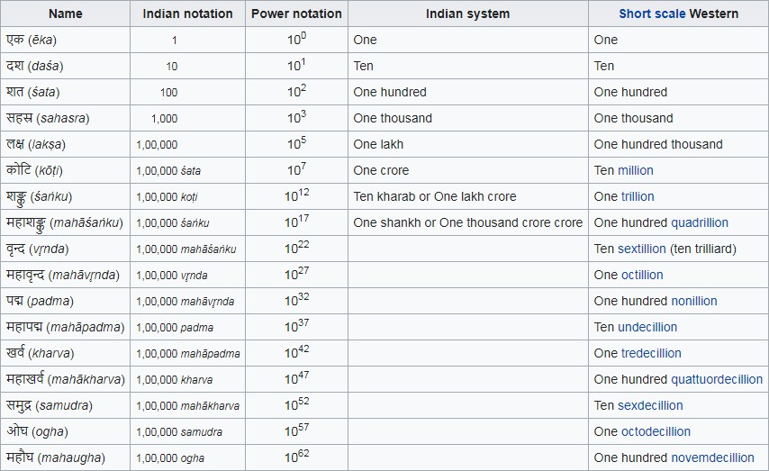
Salient Features of the Indian Numeral System

Slide 6
The Concept of Zero and Its Importance
The concept of zero was established during the period 500-300 BCE.
Ancient Indians used a decimal System that allowed them to develop a method for handling large numbers.
Brahmagupta developed a symbol for zero in 628 CE.
With this invention zero could be used as an independent numeral for computational purposes.

Slide 7
Large Numbers and their representation
Ancient Indians developed a systematic approach to the number- names that they used to describe large numbers.
Three categories of naming conventions were employed to develop the number names in Sanskrit:
i.
All numbers in the digits from 0 to 9 had unique names (sunya, ekam, dve, trini, catvari, panca, sat, sapta, asta, nava).
All numbers in the range of 11 to 99 had an additive principle for naming.
All numbers of higher powers of 10 starting form 102 were named using multiplicative principle using the unit digits as a factor for multiplication.
ii.
iii.

Slide 8
Early Use of Decimal System in Ancient India:
Vedic and Post-Vedic Texts: Early Indian texts, such as the Vedas and later works in Sanskrit, did not use a fully developed decimal numeral system but recognized the importance of large numbers and multiples of ten. Numbers were expressed in terms of powers of 10, and their representations were used in rituals, astronomy, and more.
Sulba Sutras (around 800-500 BCE): These texts, which deal with the construction of altars for Vedic rituals, contain early references to geometric concepts and measurements that implicitly utilize the decimal system in their calculations.
The Development of the Indian Decimal Place-Value System:
The decimal place-value system is a significant contribution of ancient Indian mathematics, particularly with the invention of zero as a place-holder and its role in the representation of large numbers.
The earliest known use of the decimal system, including the use of zero and place value, can be found in ancient Indian texts dating back to the 5th and 6th centuries CE.
The most notable contributions were made by mathematicians and scholars such as Brahmagupta and Aryabhata, who codified mathematical concepts that relied on the use of the decimal system.

Slide 9
Significance of the Decimal System in IKS:
Mathematical Foundations: The Indian decimal system provided the foundation for complex calculations in astronomy, physics, and engineering. It revolutionized the way numbers were used, facilitating more advanced mathematics, algebra, and calculus.
Cultural and Philosophical Importance: The development of zero, as well as the place value system, had deep philosophical and metaphysical implications in Indian thought, where concepts of nothingness, infinity, and the cyclical nature of the universe were discussed extensively in Hindu and Buddhist philosophy.
Practical Use: The decimal system allowed for precise measurements and was widely used in commerce, trade, and administration, helping to advance Indian economies and cultures.

Slide 10
Unique approaches to Represent Numbers
Ancient Indian mathematics seamlessly integrated mathematics with literature and poetry.
We find well developed systems to address this requirement and discuss two of them here:
i.
Bhuta-Samkhya system is a system of expressing numbers by means of words representing certain entities.
Katapayadi system employs a technique to convert the numerals to alphabets using certain rules.
ii.

Slide 11
Bhūtasaṃkhyā (भूतस या) system
Bhūtasaṃkhyā (भूतसं या) system is a method of recording numbers in Sanskrit using common nouns having connotations of numerical values.
The method was introduced already in astronomical texts in antiquity, but it was expanded and developed during the medieval period.
A kind of rebus system, bhūtasaṃkhyā has also been called the “concrete number notation”.

Slide 12
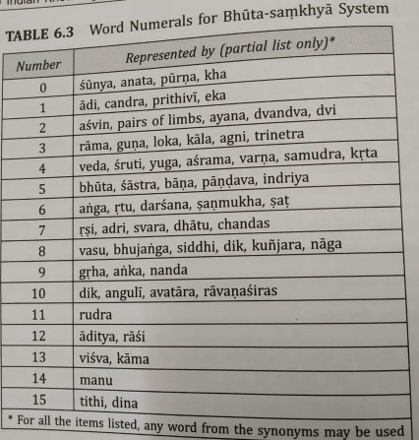
Bhūtasaṃkhyā (भूतस या) system

Slide 13
Katapayadi System
Another System to convert the numerals to words is to associate a number to one or more alphabets.
Using the alphabets in place of numbers, one can construct words, which by deciphering one alphabet at a time will reveal the number expressed in the word.
The advantage of such a system lies in representing large numbers using a word, which can be easily remembered.
This provided a very efficient method of presenting results of complex calculations using number symbols.

Slide 14
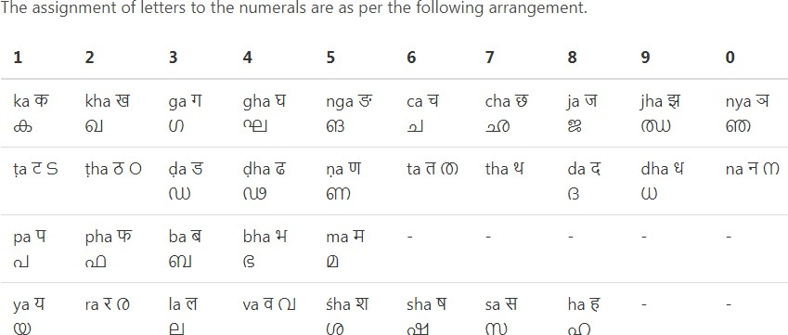
Katapayadi System

Slide 15
Pingala
Pingala, in the context of the Indian Knowledge System (IKS), is a significant figure, particularly known for his contributions to Sanskrit prosody (the study of poetic meter and rhythm) and early developments in mathematics, specifically the binary numeral system.
1. Sanskrit Prosody (Chandas):
It is most famous for his work in the field of chandas or Sanskrit prosody.
He wrote a treatise called the Chandaḥśāstra, which is one of the earliest texts to systematically explain the structure of poetic meters in Sanskrit. His analysis was based on syllable lengths, which were categorized into short (laghu) and long (guru) syllables. This work was vital for the study and creation of poetic forms in Sanskrit literature, like Vedic hymns, which follow strict metrical patterns.
Laghu and Guru: Pingala classified syllables into two categories, laghu (short) and guru (long). These became the foundation for different meter patterns in classical Sanskrit poetry.

Slide 16
2. Mathematics and the Binary System:
Pingala’s work also laid the groundwork for binary mathematics, which is incredibly significant in the development of modern computing. In his text, Chandaḥśāstra, Pingala used a binary-like system to represent different combinations of syllables (short and long).
He described the arrangement of syllables as a binary sequence—similar to how modern computers represent data using binary digits (0s and 1s).
This system involved combinations of short and long syllables, where the short syllable was represented by a "0" and the long syllable by a "1".
This is considered an early form of binary coding, which would later become fundamental in the development of digital technology.

Slide 17
3. Fibonacci Sequence:
Pingala’s work also hinted at a mathematical sequence that resembles the Fibonacci sequence. The arrangement of syllables in metrical patterns followed a structure that could be interpreted as a Fibonacci-like progression. This aspect of his work links ancient Indian knowledge to modern mathematical discoveries.
Therefore Pingala’s contributions to the Indian Knowledge System reflect a unique intersection of mathematics, linguistics, and culture.
His pioneering work in prosody and the binary system has left a lasting legacy on both the intellectual traditions of ancient India and the modern world’s technological advances.

Slide 18
Measurement For Time, Distance and Weight
In the ancient Indian literature three fundamental physical measures for quantifying length, time and weight are found.
There are several sources in the literatue specifying units of measurement for these three physical quantities.
Three generic measures pertaining to length, weight and time could be used to measure physical entites.

Slide 19
Notion of Paramanu
At the smallest level, there is a fundamental measure called paramanu.
The measure of Paramanu are as follows:
Paramanu (length): 2.88 x 10⁻⁷ mm
Paramanu (weight): 5.79 x 10⁻⁵ g
Paramanu (time): 1.31 x 10⁻⁵ seconds

Slide 20
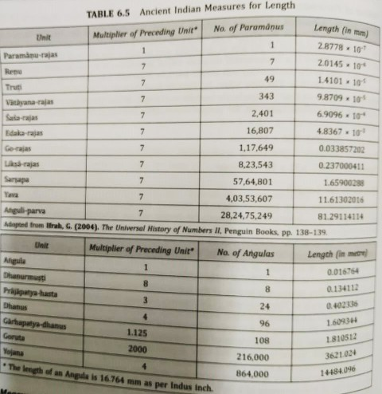
Measures for Length

